Slide 1
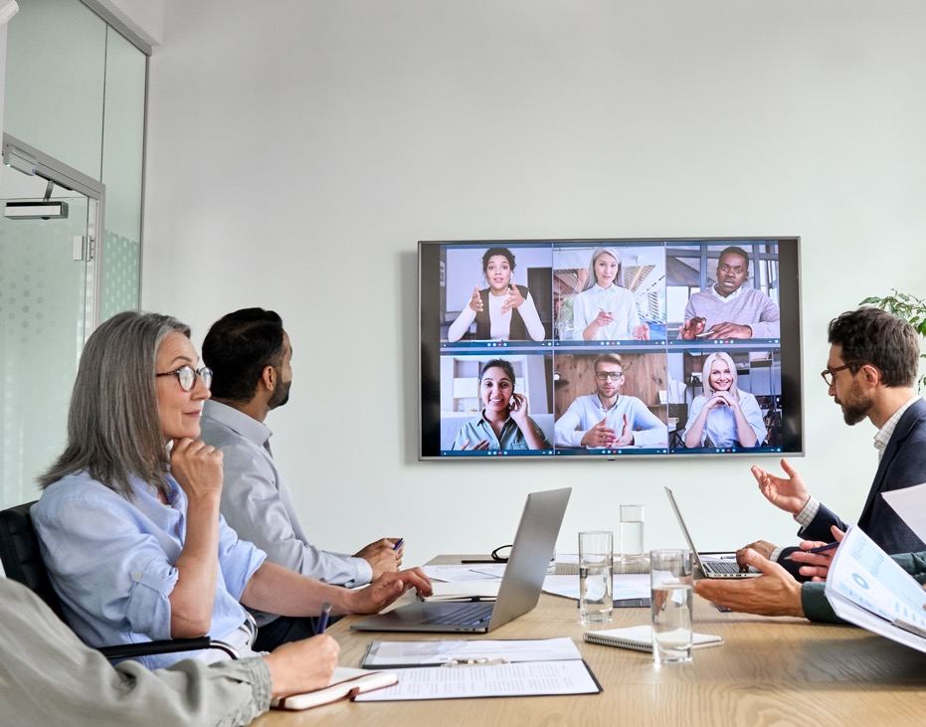
GlobeSmart® Profile
Team Debrief
Notes:
These slides are for you to use for your GlobeSmart Profile Team Debrief session. Feel free to modify them as you see fit.

Slide 2
Notes for Team Leaders and/or Facilitators
These slides are meant for use with a GlobeSmart Profile Team Debrief. Feel free to use all or just a few of them, depending on the time you have.
Please note:
There are presenter notes on each slide. Please review them.
Beginning on slide 16, the assumption is that you will be sharing your team’s Profile chart, either by including a screen shot in this presentation, or by projecting it on the screen (or having your participants view printouts of it).
As you will see on slide 17, it is also recommended that you share the “Inclusive Actions” document with your team so they can explore ideas for working with team members who may have different styles. This can be found in the Resources section of the Team Toolkit.
Consider reviewing the GlobeSmart Profile FAQ for answers to many questions about the Profile (it’s in the Teams Toolkit under the Resources section), and sample the advice offered by expert facilitators in the Video Library section of the Teams Toolkit.
If you have questions, or would like additional support, please reach out to us at Aperian.

Slide 3
Objectives
Increase collaboration and effectiveness on our team by:
1. Understanding the impact of style differences on our team interactions
2. Identifying and bridging those differences
3. Creating a plan around what we’ll do differently (align on team ”norms”)

Slide 4
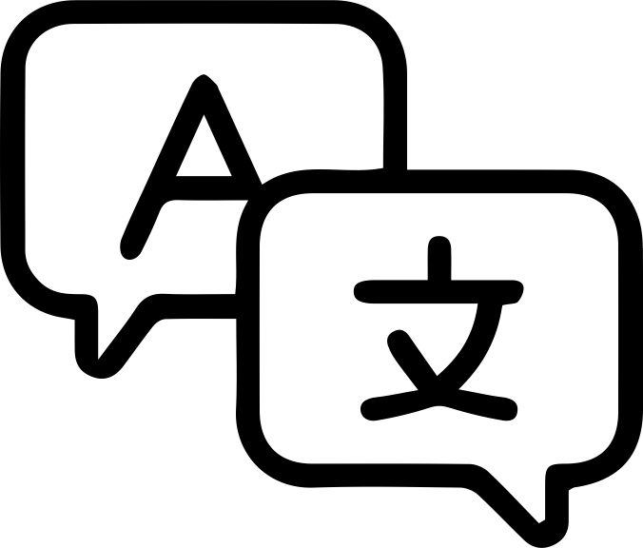

Challenges Working on a Global, Virtual Team
Language
Barriers
Understanding
Protocol
Time Zones
and Distance
Communicating
Virtually
Resolving
Conflict
Motivating; Creating
a Sense of Urgency
Building Relationships Across Cultural Differences
Problem Solving and
Decision Making
Leading a
Virtual Team
Notes:
Ask the team which of these challenges they face.

Slide 5


The Colored Lens Through Which We See
Person A
Person B
Visible
Behaviors
Behaviors
Attitudes
Assumptions
Beliefs
Values
Attitudes
Assumptions
Beliefs
Values
Drives & Shapes Behaviors
Less visible
Notes:
We all see the world through the lens of our own culture. The lens is created from our attitudes, assumptions, beliefs and values. This not only drives and shapes our behavior, but it colors the way we see other’s behaviors. In order to understand why others do things the way that they do, we need to understand the attitudes, assumptions, beliefs and values that are driving their behavior, and not assume those drivers are the same as ours.

Slide 6
Stereotypes & Generalizations
NEW INFORMATION
Most
Many
Some
Usually
Typically
Generally
Always
Never
All
None
Either/Or
Stereotypes
Generalizations
Fixed and oversimplified opinions or judgments
General statements
or ideas supported by research
Notes:
It’s useful to distinguish between Stereotypes and Generalizations.
Stereotypes are fixed and oversimplified opinions or judgments. When we stereotype, we use words like Always, Never, All, Noon, Either/Or, etc. We do not allow new information to enter our minds that might alter our views.
Generalizations, on the other hand, are general statements or ideas supported by research. When we generalize, we use words like Most, Many, Some, Usually, Typically, Generally, etc. We constantly seek out and accept new information, and we adjust our views as needed, based on new information.
The GlobeSmart Profile is based on generalizations about culture and work styles; we always seek to avoid stereotyping.

Slide 7
Work Styles
National
Culture
This diagram illustrates a few of the many factors that influence our individual work styles.
Our styles ‘frame’ the way we see the world and the way we engage with the people around us.
Learning to interact effectively with people with different styles is key to getting things done.
Professional
Specialty
Individual
Style
What
Else?
Corporate
Culture
Level of
Experience
Notes:
Our preferred work styles are made up of many factors, as is shown on this slide. There’s no ‘right’ or ‘wrong’ style, but it is useful to understand our own styles as well as the styles of the people with whom we are working if we want to be able to collaborate effectively with them. This is how the GlobeSmart Profile can help. It helps us understand our own preferred styles, and then allows us to compare with the preferred styles of others, generating advice on how we can adapt our styles as needed to be more effective.

Slide 8
GlobeSmart Profile Dimensions
Independent
Interdependent
Egalitarianism
Status
Risk
Certainty
Direct
Indirect
Task
Relationship
Notes:
Be sure to point out to your team that the GlobeSmart Profile dimensions are all on a continuum; there is no ‘right’ or ‘wrong’ or ‘better’ or ‘worse’ style. One’s placement on the dimensions is not a predictor of success. The purpose of the GlobeSmart Profile is simply to see how our tendencies – our preferred styles - are similar or different from each other, and when they’re different, to learn how we can collaborate most effectively.

Slide 9
How to Use the GlobeSmart Profile
Your goal is to know your profile and that of your colleague
in order to leverage similarities and bridge differences.
You
Your Colleague
Note:
Dimensions are on a continuum
There is no “right” or “wrong” style
Profile result is not a predictor of success
Notes:
Be sure to point out to your team that the GlobeSmart Profile dimensions are all on a continuum; there is no ‘right’ or ‘wrong’ or ‘better’ or ‘worse’ style. One’s placement on the dimensions is not a predictor of success. The purpose of the GlobeSmart Profile is simply to see how our tendencies – our preferred styles - are similar or different from each other, and when they’re different, to learn how we can collaborate most effectively.

Slide 10
Style Switching / Frame Shifting
A tactic that allows you to adapt your style
in order to bridge differences.
Switching your style does not mean you are changing who you are.
It is a tool you can use when differences in work styles are preventing you from meeting your objectives.
Very
Direct
Very
Indirect
Direct
Indirect
Somewhat
Direct
Somewhat
Indirect
Notes:
The ability to shift one’s style is crucial when working across differences. As an example, if someone is typically very direct in their communication style, then it may be useful for them to learn how to speak softer, listen harder, read between the lines, and give feedback more subtly when they are working with people who are more indirect.

Slide 11
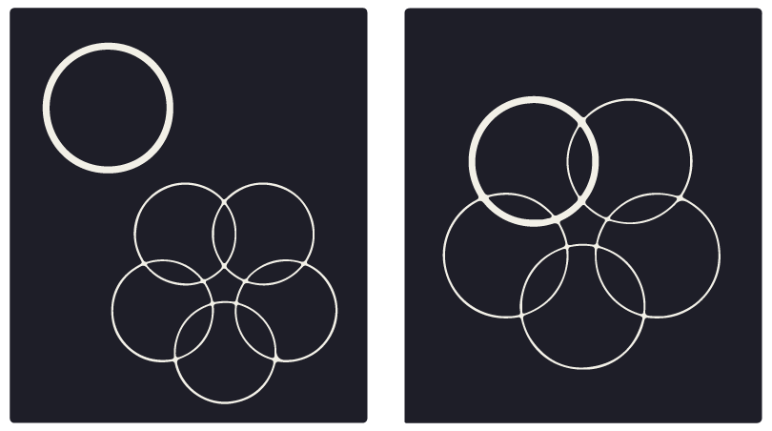
Key Dimensions of Culture and Work Styles
How do I derive my identity?
Independent
Place great importance on individual identity
Derive identity from personal choices and achievements
Prefer taking action on one's own
Interdependent
Place great importance on group harmony and cooperation
Derive identity from group affiliation
Feel a sense of duty, obligation, and loyalty to ascribed groups
Notes:
The theme of this dimension is the extent to which I derive my identity from my own choices and actions, or from the groups to which I belong.

Slide 12
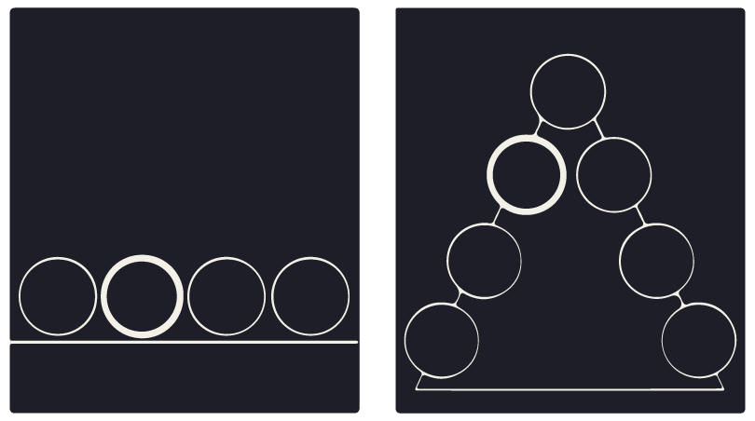
Key Dimensions of Culture and Work Styles
What is my preference for how my group
should be structured and power should be distributed?
Egalitarianism
Be comfortable challenging the views of superiors
Be flexible about roles
Treat everyone much the same
Assume power and authority should be shared broadly among a group
Status
Prefer not to challenge those above them
Be deferential to superiors
Adapt behavior depending on relative status
Assume power and authority should be reserved for a few members of a group
Notes:
The theme of this dimension is how I feel power and authority should be distributed in a work group; do I think we are all more or less equals, or is it important to have and respect a strong hierarchy?

Slide 13
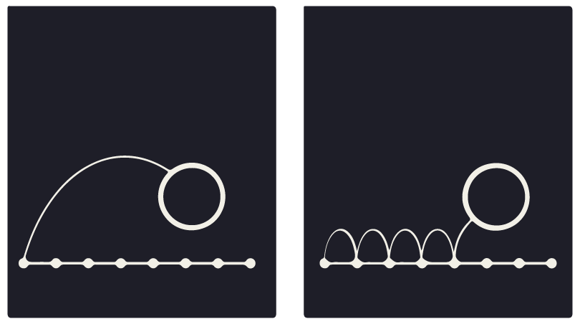
Key Dimensions of Culture and Work Styles
How do I make decisions in uncertain or ambiguous situations?
Risk
Prefer rapid decision-making and quick results
Place great importance on flexibility and initiative
Value speed over thoroughness
Can make the rules as they go
Comfortable making mistakes; ‘fail fast’
Certainty
Spend significant time on background research
Establish proper procedures before starting a project
Value thoroughness over speed
Need to know the rules
Mistakes are to be avoided
Notes:
The theme of this dimension is how much flexibility and spontaneity do I prefer vs. structure and proper procedures.

Slide 14
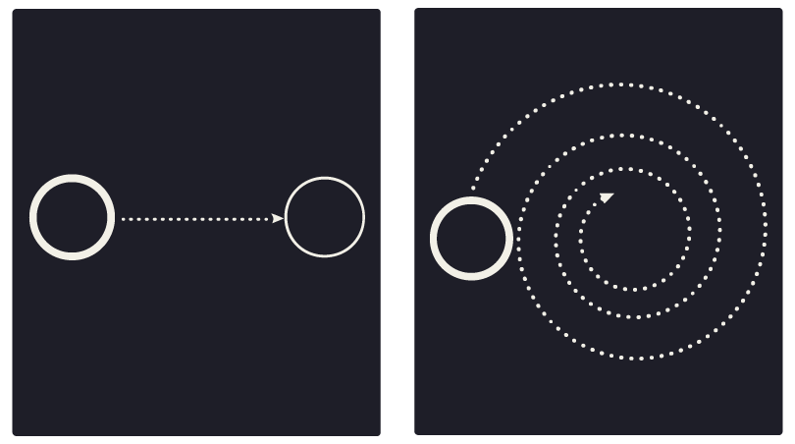
Key Dimensions of Culture and Work Styles
How do I communicate requests, ask questions, and give feedback?
Direct
Come to the point quickly
Be forthright in asking questions in most settings
Feel comfortable disagreeing with others and making requests
Give negative feedback directly
“Yes” means yes; it’s ok to say “No”
Indirect
Spend time explaining the context before coming to the point
Avoid disagreeing and making requests in public settings
Give negative feedback indirectly
“Yes” does not always mean yes; it’s often not ok to say ”no”
Notes:
The theme of this dimension is the level of directness with which I communicate requests, ask questions, respond to others, and give feedback.

Slide 15
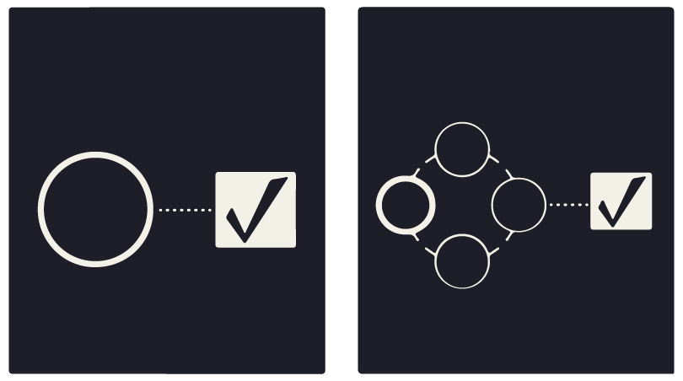
Key Dimensions of Culture and Work Styles
When working on new projects, do I prefer to
address tasks first, or relationships first?
Task
Move quickly to tasks; get to know people later
Trust is built by reaching goals on schedule
Time is generally fixed and controlled
Relationship
Time spent building relationships is key to achieving good results
Trust is built by developing close personal relationships
Time tends to be fluid and flexible
Notes:
The theme of this dimension is the extent to which I am comfortable – and feel its appropriate – working on tasks without first having built strong relationships with the people with whom I am working.

Slide 16
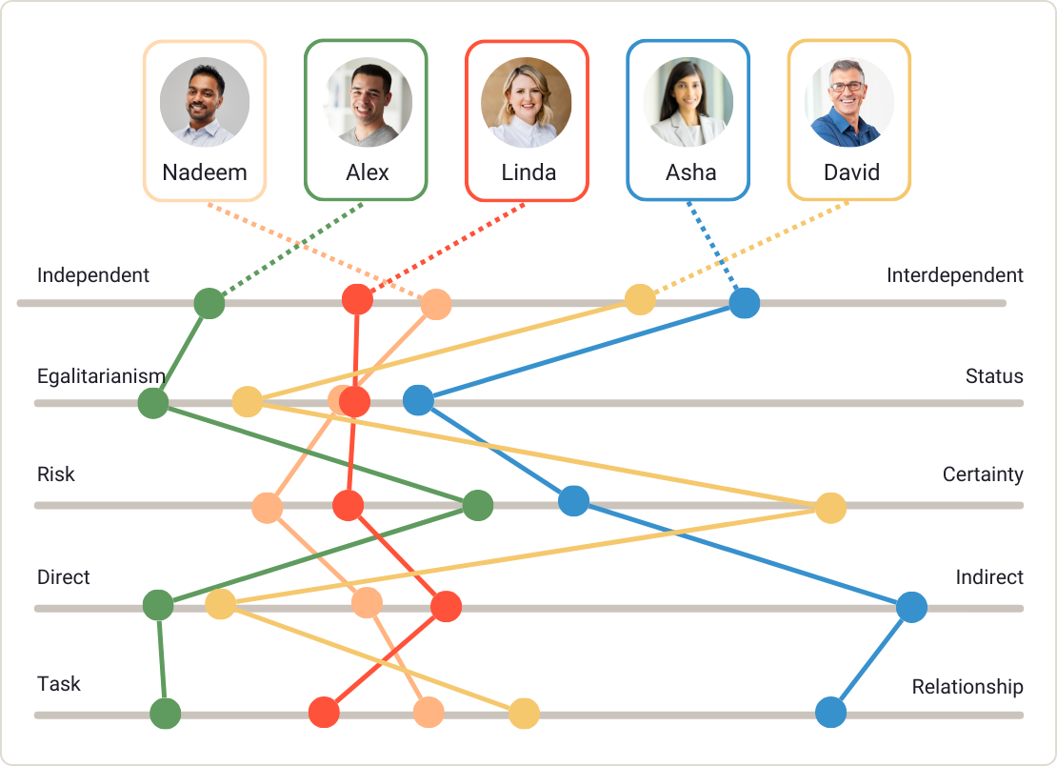
View your Team’s Profile… Part I
Looking at your team profile together, respond to these questions:
How do you see your own Profile reflected in your work?
What do you notice about the profiles of the team? Where do we have similarities?
Where there are differences, can you think of examples of how these differences play out in our team dynamics?
Notes:
Insert (or project on screen) your Team Profile chart and ask the team the questions on the screen. Remind them that there is no “right” or “wrong” place to be on these dimensions and that having diverse styles can be useful in avoiding ‘group think’ and ensuring the team isn’t overlooking issues that may be critical for other stakeholders.
You can also review the GlobeSmart Profile FAQ for answers to many questions about the Profile (it’s in the Teams Toolkit under the Resources section), and sample the advice offered in the Video Library section of the Teams Toolkit.

Slide 17
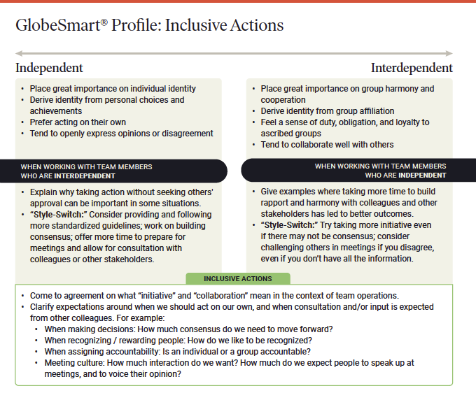
Inclusive Actions Your Team Can Take
Review the Inclusive Actions document on your screens (or printouts). The layout you see here is the same for each of the five dimensions.
Characteristics of each side of the dimension
Suggestions for adapting your style when working with people on the other side of the dimension
Ideas for building ‘norms’ for the team as whole
Notes:
Share the Inclusive Actions Your Team Can Take document with your team before moving on (it’s in the Teams Toolkit under the Resources section). Then, move to the next slide and ask the team members to consider how the suggestions under each of the dimensions could be applied to enable greater collaboration among the team.

Slide 18
View your Team’s Profile… Part II
Questions for individual team members:
What do you see in your own Profile that would be important for this team to know about you?
Are there things that others could do based on your profile that might make it easier to work with you?
Notes:
Ideally break into small groups if you have more than 6 or 7 team members; assign one person to share the discussion when you regroup as a larger team. Ask the team members to review the document, Inclusive Actions Your Team Can Take, and consider how the suggestions under each of the dimensions could be applied to enable greater collaboration among the team.

Slide 19
View your Team’s Profile… Part III
Final questions for the team:
What actions can we take that would support team members who have different styles? Can we leverage those differences to the team’s benefit?
If most of us are close to each other on some of these dimensions, what might we be missing when we interact with people outside of our team? What other work styles might we need to consider?
Notes:
Again, remind the team that there is no “right” or “wrong” place to be on these dimensions and that having diverse styles can be useful in avoiding ‘group think’ and ensuring the team isn’t overlooking issues that may be critical for other stakeholders.
Continue having the team use the document, Inclusive Actions Your Team Can Take, and consider how the suggestions under each of the dimensions could be applied to enable greater collaboration among the team.
As a reminder, you can also review the GlobeSmart Profile FAQ for answers to many questions about the Profile (it’s in the Teams Toolkit under the Resources section), and sample the advice offered in the Video Library section of the Teams Toolkit.

Slide 20
Action Planning

Slide 21
Action Plan / ”Norming” Discussion
What, if any, team norms do we want to create around how we communicate, handle disagreements, take initiative, give feedback, make decisions, etc…?
Notes:
Conduct this discussion in small groups or as a full team, depending on the size of your team.

Slide 22
Start, Stop, Continue
In order to collaborate more effectively going forward, I/we will…
Start
Stop
Continue
What will we start doing?
What will we stop doing?
What will we continue doing?
Notes:
Have the team members reflect on the session and ask them, either individually or collectively, what they are willing to do to enhance collaboration on the team:
What will you start doing?
What will you stop doing, or do less of?
What will you continue doing, or do more of?

Slide 23
Appendix

Slide 24
The Platinum Rule for Collaborating Across Style Differences
The Golden Rule:
Treat others how you want to be treated.
The Platinum Rule :
Treat others how they want to be treated.
Notes:
Share this slide during your session if you find it useful. You will find a helpful explanation in this short video: https://fast.wistia.com/embed/channel/q6ojmgk3eu?wchannelid=q6ojmgk3eu&wmediaid=q05k9wrayy

Slide 26
